Slide 1
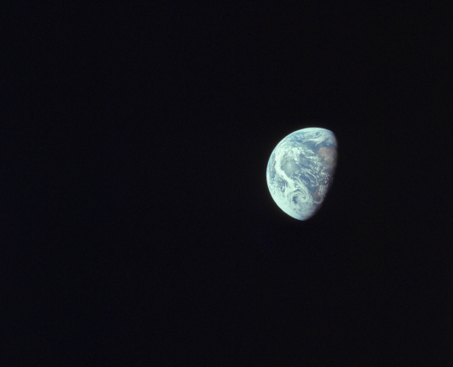



Nitrogen Storage in the Deep Interiors of Rocky Planets
Shradha Ravikumar, S.-H. Dan Shim
Arizona State University, School of Earth and Space Exploration
Arizona Space Grant Statewide Symposium
Hilton Tucson East, Tucson, AZ
April 23, 2022
Image Source: https://www.visibleearth.nasa.gov/images/144427/all-of-you-on-the-good-earth/144427f

Slide 2
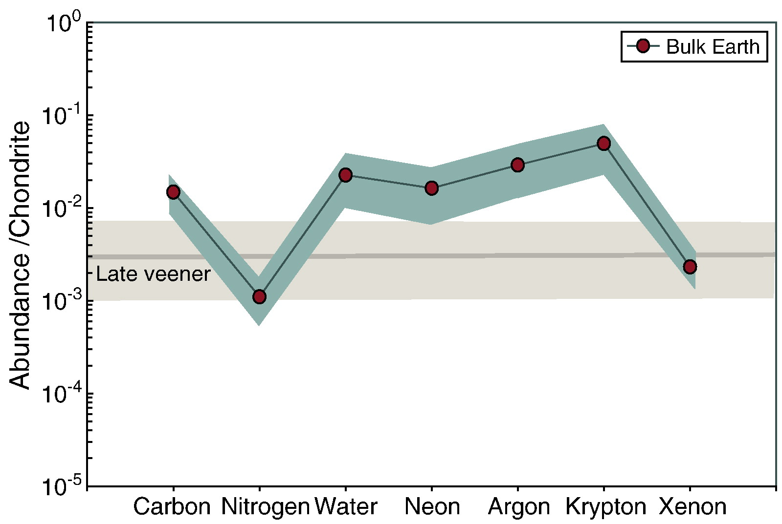
Why study nitrogen storage?
Source: Marty et al. 2012
Earth’s “missing nitrogen” problem
Mantle transition zone (~500 to 660 km depth)

Slide 3
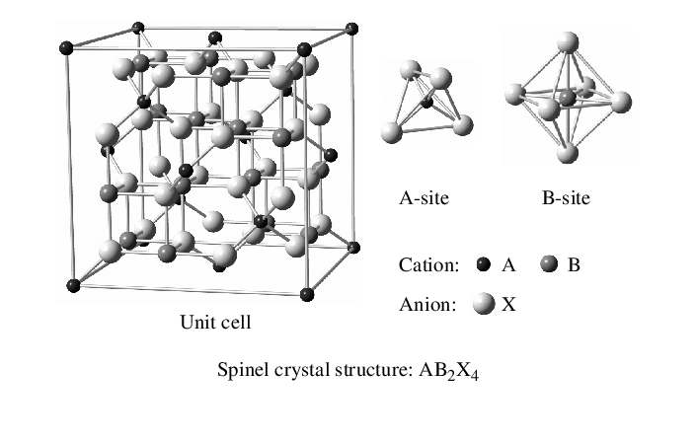
How could N be sequestered?
Source: Nagata 2005
Solid solution between ringwoodite (Mg₂SiO₄) and silicon nitride (Si₃N₄)

Slide 4


Density-Functional Theory (DFT)
What is DFT?
Approximates electronic structure and material properties of solids using quantum mechanics
Software: GPAW, ASE in Python
ASU Agave Supercluster
Image Source: https://gitlab.com/ase/ase
Image Source: https://wiki.fysik.dtu.dk/gpaw/devel/devel.html?highlight=logo

Slide 5
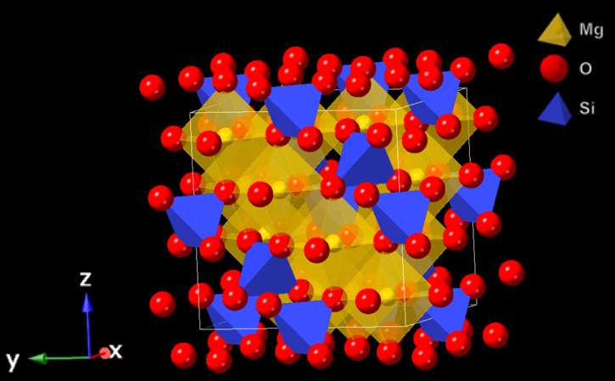
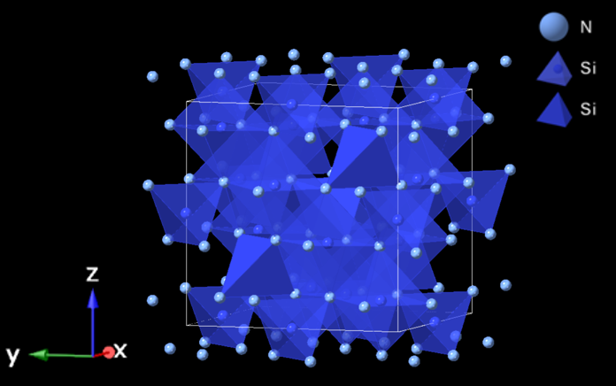
End-Member Data
Internal energy (U)
Volume (V)
0-25 GPa (5 GPa intervals)
k-points: 8, 8, 8
Encut value: 800
XC functional: LDA
Ringwoodite
(Mg₂SiO₄)
Silicon Nitride (Si₃N₄)

Slide 6
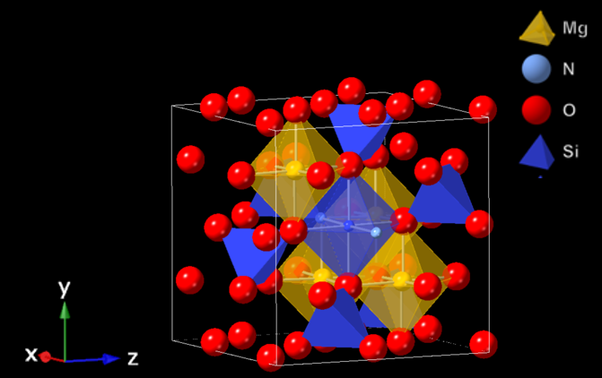
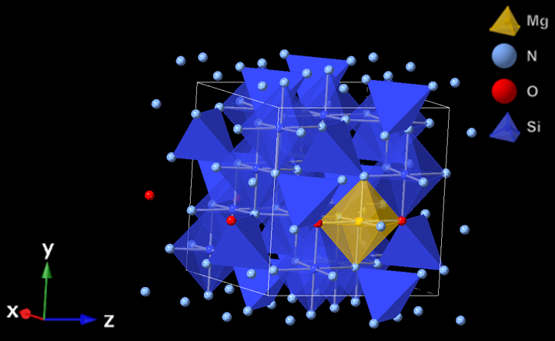
Solid Solution Data
6.25 mol% Silicon Nitride (Si₃N₄)
93.75 mol% Silicon Nitride (Si₃N₄)

Slide 7
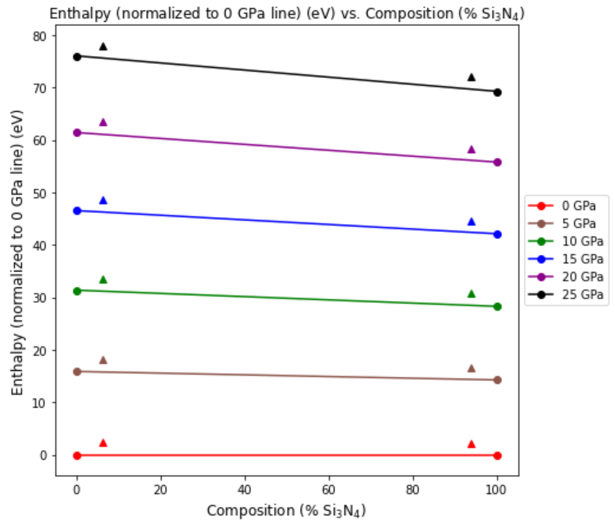
Assessing Stability
Change in internal energy
Pressure
ΔH = ΔU + PΔV
Change in enthalpy
Change in unit cell volume

Slide 8
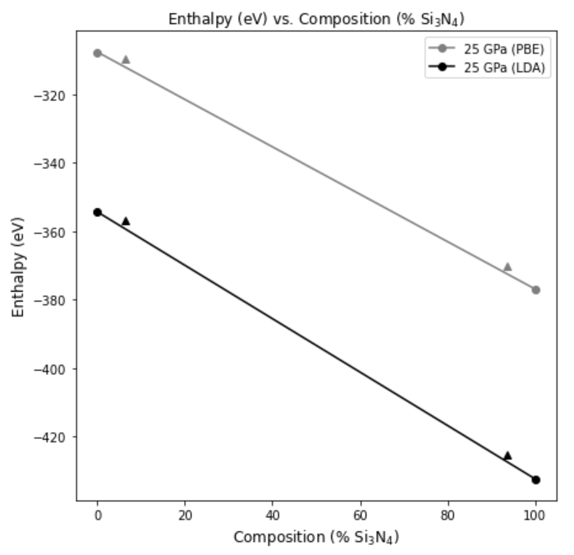
Assessing Stability (XC Functional: PBE)
Change in internal energy
Pressure
ΔH = ΔU + PΔV
Change in enthalpy
Change in unit cell volume

Slide 9
Significance and Future Work
With varying pressure, ringwoodite/silicon nitride mixture is unstable
DFT limitations
High-temperature effects
Experimental synthesis of solid solution
ASU’s multi-anvil press
Implications
Earth’s atmospheric evolution, habitability
Terrestrial planets, rocky exoplanets

Slide 10
Thank You!
Acknowledgements
I would like to thank Dr. Dan Shim for his mentorship and guidance on this project. I would also like to thank the other members of the Dan Shim Lab for their time and input, and the ASU/NASA Space Grant Program for funding this work.

Slide 11
Sources
Marty, B. (2012). The origins and concentrations of water, carbon, nitrogen and noble gases on Earth. Earth and Planetary Science Letters, 313–314(1), 56–66.
Nagata, S. (2005). Metal-Insulator Transition in the Thiospinel CuIr₂S₄. Chinese Journal of Physics (Taipei), 43(3S), 722-735.

